Slide 1
ETHICAL SERVICE
AWARENESS · ENGAGEMENT · ACCOUNTABILITY
Orientation for Executive Branch Employees

Slide 2
ETHICAL CONDUCT
“Ethical conduct” involves just that—conduct. It is a measure of how well you make decisions and perform your duties in accordance with public service principles and standards.

Slide 3
OUR PRINCIPLES & STANDARDS OF ETHICAL CONDUCT
We are committed to upholding the highest principles and standards of ethical conduct in all that we do. We apply these principles and standards in the course of our daily work, and by faithfully observing them, we safeguard the honor of public service and the reputation of the executive branch. Through them, we hold ourselves and each other accountable for the integrity of our service to our country and to our fellow citizens.

Slide 4
YOUR COMMITMENT
Fulfilling the expectation of ethical service requires:
Awareness: becoming familiar with ethical principles, rules, and laws.
Engagement: cultivating habits of asking questions and seeking advice.
Accountability: acting in ways that reflect the expectations of public service and holding ourselves and each other accountable.

Slide 5
AWARENESS
1
CHAPTER
We are guided in our conduct by a set of principles and a specific and enforceable set of standards and laws.

Slide 6
GENERAL PRINCIPLES
Respect the rule of law.
Do not misuse your public position for private gain.
Be responsible in the use of your time and resources.
LOYALTY TO LAW
SELFLESS SERVICE
RESPONSIBLE STEWARDSHIP

Slide 7
STANDARDS OF ETHICAL CONDUCT
Use of Government Position
Conflicting Financial Interests
Impartiality
Seeking Other Employment
Outside Activities
Gifts from Outside Sources
Gifts Between Employees

Slide 8
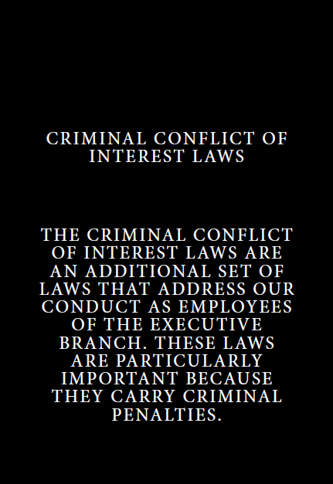
CRIMINAL CONFLICT OF INTEREST LAWS
[Should you elect to also introduce new employees to the Criminal Conflict of Interest Laws, this is a placeholder slide for you to use. Delete this slide if not being used.]

Slide 9
SCENARIOS
[Select or create scenarios that will be beneficial to your agency’s employees. If selecting from those provided, re-number your topics and scenarios accordingly. Delete these instructions before finalizing your presentation.]

Slide 10
TOPIC [1] – MISUSE OF POSITION AND RESOURCES

Slide 11
TOPIC [1]: SCENARIO [1]
In the office, you notice some of your colleagues have their personal email and social media accounts open on their government-issued laptops.
WHAT DO YOU THINK?
WHAT WILL YOU DO?

Slide 12
TOPIC [1]: SCENARIO [2]
A friend asks you to help their daughter get an internship at another government agency.
WHAT DO YOU THINK?
WHAT WILL YOU DO?

Slide 13
TOPIC [1]: SCENARIO [3]
You have a family member who owns a business that could be of use to our agency.
WHAT DO YOU THINK?
WHAT WILL YOU DO?

Slide 14
TOPIC [2] – CONFLICTS OF INTEREST AND IMPARTIALITY

Slide 15
TOPIC [2]: SCENARIO [1]
You have entered the government from the private sector. Your former employer does business with, or is affected by, the programs of our agency.
WHAT DO YOU THINK?
WHAT WILL YOU DO?

Slide 16
TOPIC [2]: SCENARIO [2]
You have a brokerage account that invests in various securities (i.e., stocks, bonds, mutual funds, exchange-traded funds (ETFs)).
WHAT DO YOU THINK?
WHAT WILL YOU DO?

Slide 17
TOPIC [2]: SCENARIO [3]
Your spouse’s employer does business with, is regulated by, is a grantee of, or is otherwise affected by the work of our agency.
WHAT DO YOU THINK?
WHAT WILL YOU DO?

Slide 18
TOPIC [3] – OUTSIDE ACTIVITIES AND SEEKING EMPLOYMENT

Slide 19
TOPIC [3]: SCENARIO [1]
You have an outside business, and you are always looking for new customers/clients.
WHAT DO YOU THINK?
WHAT WILL YOU DO?

Slide 20
TOPIC [3]: SCENARIO [2]
You make a little extra income selling your handmade jewelry online.
WHAT DO YOU THINK?
WHAT WILL YOU DO?

Slide 21
TOPIC [3]: SCENARIO [3]
You serve in a leadership position in the Parent Teacher Association at your child’s school, which engages in fundraising.
WHAT DO YOU THINK?
WHAT WILL YOU DO?

Slide 22
TOPIC [4] – GIFTS FROM OUTSIDE SOURCES

Slide 23
TOPIC [4]: SCENARIO [1]
In your day-to-day work, you may deal with contractors or vendors, grantees, or people who work for regulated organizations. Over time, you may get to know these people more personally.
WHAT DO YOU THINK?
WHAT WILL YOU DO?

Slide 24
TOPIC [4]: SCENARIO [2]
The new contractor in your office is your best friend from college, and they invite you out to lunch.
WHAT DO YOU THINK?
WHAT WILL YOU DO?

Slide 25
TOPIC [4]: SCENARIO [3]
You received a special discount for a training, which was sent to your .gov email account.
WHAT DO YOU THINK?
WHAT WILL YOU DO?

Slide 26
TOPIC [5] – GIFTS BETWEEN EMPLOYEES

Slide 27
TOPIC [5]: SCENARIO [1]
It’s the holiday season, and your office is excited to celebrate together. You are asked to help decorate the conference room, participate in a gift exchange, contribute food and/or funds for the office’s holiday party, and chip in for a gift to your boss.
WHAT DO YOU THINK?
WHAT WILL YOU DO?

Slide 28
TOPIC [5]: SCENARIO [2]
Your immediate supervisor sends an email to all staff suggesting that everyone should attend a retirement luncheon for his boss, your manager. You must pay to attend the luncheon.
WHAT DO YOU THINK?
WHAT WILL YOU DO?

Slide 29
ETHICS OFFICE INFORMATION
14 General Principles of Ethical Conduct (PDF)
Summary of the Standards of Ethical Conduct (PDF)
Summary of the Criminal Conflict of Interest Laws (PDF)
[Insert your ethics office’s contact information (e.g., email address, phone number).]

